Slide 1
camp.SITE
Group Project 3

Slide 2
The Problem
Quarantine is causing cabin fever.
People want to get away but still want to stay safe.
Camp sites are often booked up to 6 months in advance.

Slide 3

The Solution
A search platform to find campgrounds with last minute availability

Slide 4
MVP
Target audience: People looking for somewhere to camp without planning in advance.
User stories:
As a prospective camper, I want to be able to see which campgrounds are close to me.
As a prospective camper, I want to see only campgrounds that have availability in the next 5 days.
As a prospective camper, I want to know where to make a reservation online for the campground I’ve selected.

Slide 5
The Team
Robert Alanis – Front End
Steven Bowler – Backend
Kyla Fitzpatrick – Backend
Gabrielle Byers – Backend

Slide 6
The Approach
MERN Stack
Mongoose DB Models:
Campground
User
React/Redux
External API: Recreation.gov

Slide 7
New Technologies
JSON Web Tokens
Bcrypt Password Encryption
Hapi/Joi Input Validation
Google Geolocation/Geocodes API
Trello
Travis CI
User Authentication
Moment npm package
React Spinners
ReactStrap

Slide 8
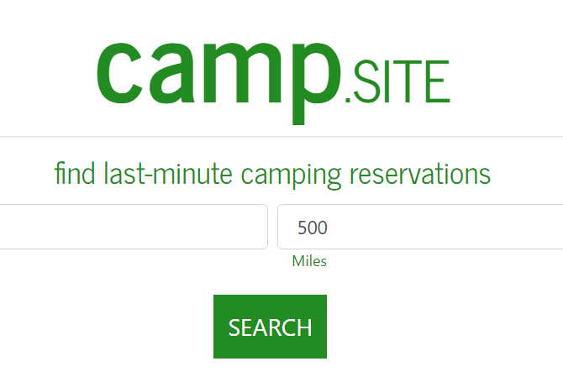
Project Demo
http://campingproject3.herokuapp.com/

Slide 9
Challenges
Lack of API Documentation
Inconsistent API data
Validation
Redux

Slide 10
Future Enhancements
Search Filters
Save Filter Settings
Map Feature

